Slide 1
45 Day Check-in
GO Team Meeting #3

Slide 2
Agenda
CIP-45 Day Check-in
Fall ACES Presentation
School Strategic Plan
Discussion on Strategic Plan and progress
Updates for Strategic Plan (as necessary)
Preparing for the Budget Development
Rank Strategic Priorities

Slide 3
Timeline for GO Teams
You are HERE
Fall 2021
GO Team Developed 2021-2025 Strategic Plan
1
Summer 2022
School Leadership completed Needs Assessment and defined overarching needs for SY22-23
2
August 2022
School Leadership completed 2022-2023 Continuous Improvement Plan
3
Sept. – Dec. 2022
Utilizing current data, the GO Team will review & possibly update the school strategic priorities and plan
4
Before Winter Break
GO Team will take action (vote) on the school’s strategic plan and vote on the ranked strategic plan priorities for SY23-24 budget discussions.
5
1
2
3
4
5

Slide 4
Quarterly CIP Check-in
As part of the Continuous Improvement process, all APS schools are completing a quarterly check-in for the Continuous Improvement Plans.
Questions to Consider
Based on our year long CIP plan, what are the actions that the school has already completed?​
What data supports the completion of an action step and success criteria (both implementation and student achievement)?

Slide 5
CIP Check-In

Slide 6
CIP Check-in

Slide 7
CIP Check-in

Slide 8
CIP Check-in

Slide 9
Accountability
Collaboration
Equity
Support
NOTE to Principal: Please insert your ACES presentation after this slide.
Fall 2022 ACES Presentation

Slide 14
Strategic Plan Progress

Slide 15
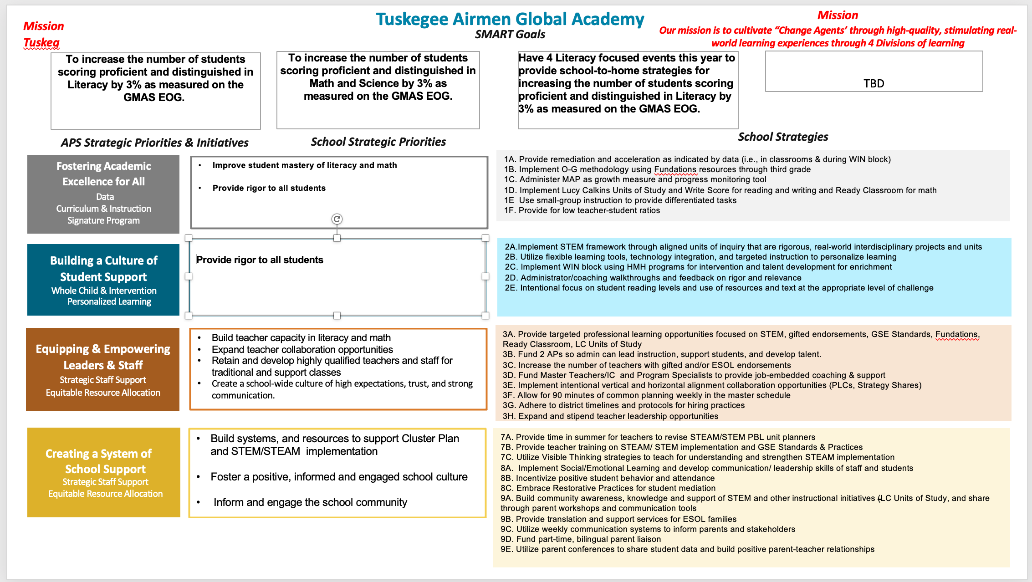
Our Strategic Plan

Slide 16
Activity & Discussion
Review the priorities and goals in your strategic plan and reflect on if the expected progress is being made. These guiding questions will help you determine what, if any, updates are needed for your school’s strategic plan.
Are all CIP Goals reflected in our Strategic Plan Priorities? If not, which CIP Goal(s) are missing and should be added to the Strategic Plan?
What progress has been made towards the priorities identified in our Strategic Plan? What evidence/data do we have?
Based upon available data, are there any other adjustments we need to make to the Strategic Plan?

Slide 17
Updates to the
Strategic Plan
Retain and develop highly qualified teachers/staff
Build teacher capacity
Establish systems and resources to support STEM/STEAM based curriculum
Improve student mastery of math and literacy
Provide rigor
Expand teacher collaboration
Foster a positive, informed and engaged school culture
Inform and engage the school community
Create a culture high-expectations school wide

Slide 18
Questions?
Wonderings?
Comments?

Slide 19
Preparing for Budget Development

Slide 20
You are HERE
Fall 2021
GO Team Developed 2021-2025 Strategic Plan
1
Summer 2022
School Leadership completed Needs Assessment and defined overarching needs for SY22-23
2
August 2022
School Leadership completed 2022-2023 Continuous Improvement Plan
3
Sept. – Dec. 2022
Utilizing current data, the GO Team will review & update the school strategic priorities and plan, as needed
4
Before Winter Break
GO Team will take action (vote) on the school’s strategic plan and vote on the ranked strategic plan priorities for SY23-24 budget discussions.
5
1
2
3
4
5

Slide 21
Action on the Updated Strategic Plan
The GO Team needs to TAKE ACTION (vote) on its updated Strategic Plan. After the motion and a second, the GO Team may have additional discussion. Once discussion is concluded, the GO Team will vote.

Slide 22
Discussion
Strategic Plan Priority Ranking
In preparation for the 2023-2024 Budget Development (January–March 2023), the GO Team needs to rank its Strategic Plan Priorities. Use the next slide to capture the priority ranking.

Slide 23
Action on the Strategic Plan Priorities
The GO Team needs to TAKE ACTION (vote) on its ranked Strategic Plan Priorities. After the motion and a second, the GO Team may have additional discussion. Once discussion is concluded, the GO Team will vote.

Slide 24
Where we’re going
At our next meeting(s) we will begin the discussion of the 2023-2024 budget.
Let me or the Chair know of any additional information you need for our future discussion.

Slide 25
Thank you

